Slide 1

Introduction to Scripting for image analysis

Slide 2
10:00 – 11:00
Introduction to Scripting with FIJI
11:15 – 12:00
Interactive Seminar – Basic Scripting Commands 1
13:00 – 14:00
Lunch
14:00 – 15:30
Workshop 1: Batch Processing Template
15:45 – 17:30
Workshop 2: Automating Processing
11:00 – 11:15
Coffee
12:00 – 12:15
Coffee
15:30 – 15:45
Coffee
12:15 – 13:00
Interactive Seminar – Basic Scripting Commands 2

Slide 3
What do we hope to achieve
Load Image
Split Channels
Save Separate Channels
Build a batch processing template
Load Image
Split Channels
Save Result
Perform Some Task
Customise template for specific task

Slide 4
Part 1:
Introduction to Scripting with FIJI
Variables and Arrays
Part 2:
Flow Control
Built-In Functions
Part 3:
Workshop: Batch Processing Template
Ongoing:
?

Slide 5





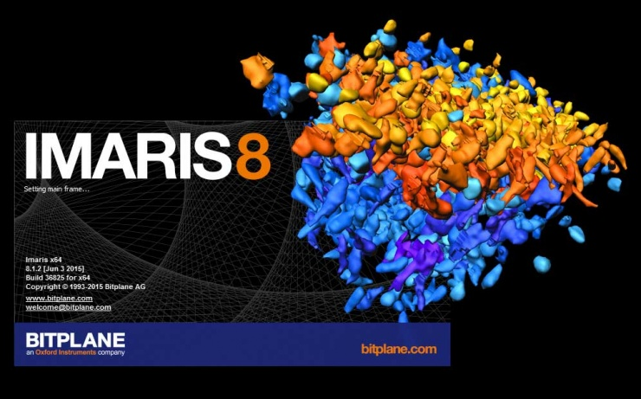


Slide 6
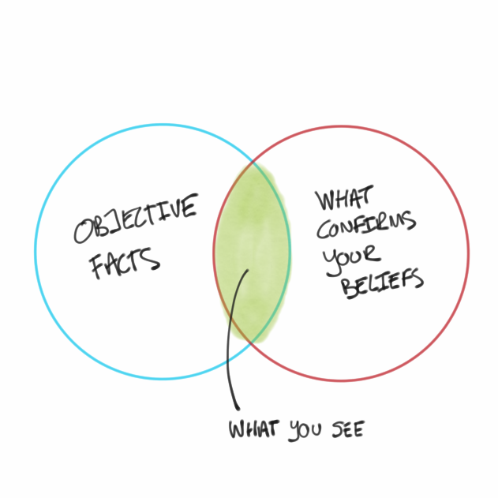
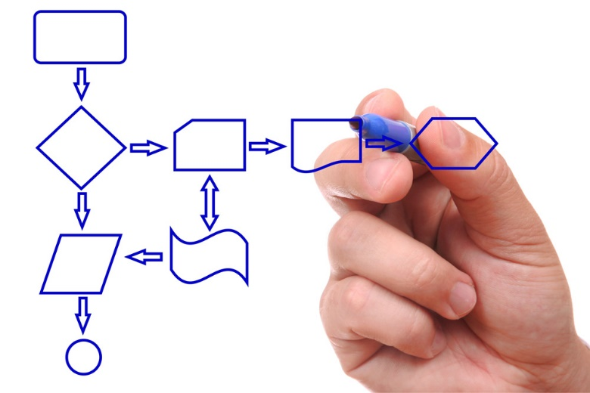
Why use scripts?
Load Image
Filter
Segment
Analyse
Save Results
Scripts (or macros) can be used to…
Automate repetitive tasks
Reduce user interaction & bias
Document & share common procedures

Slide 7
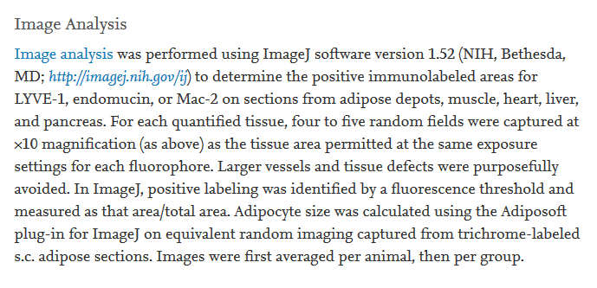
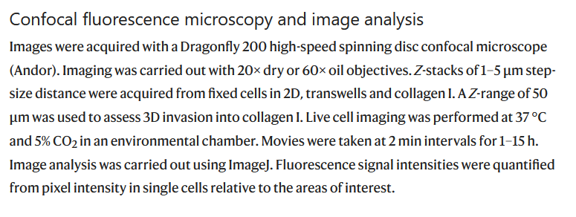
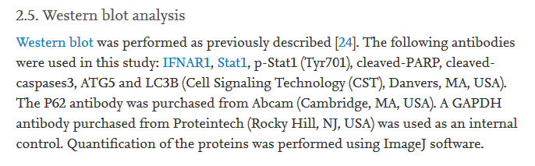
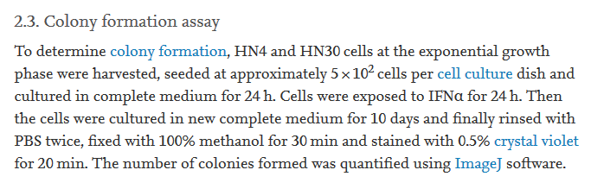

Slide 8
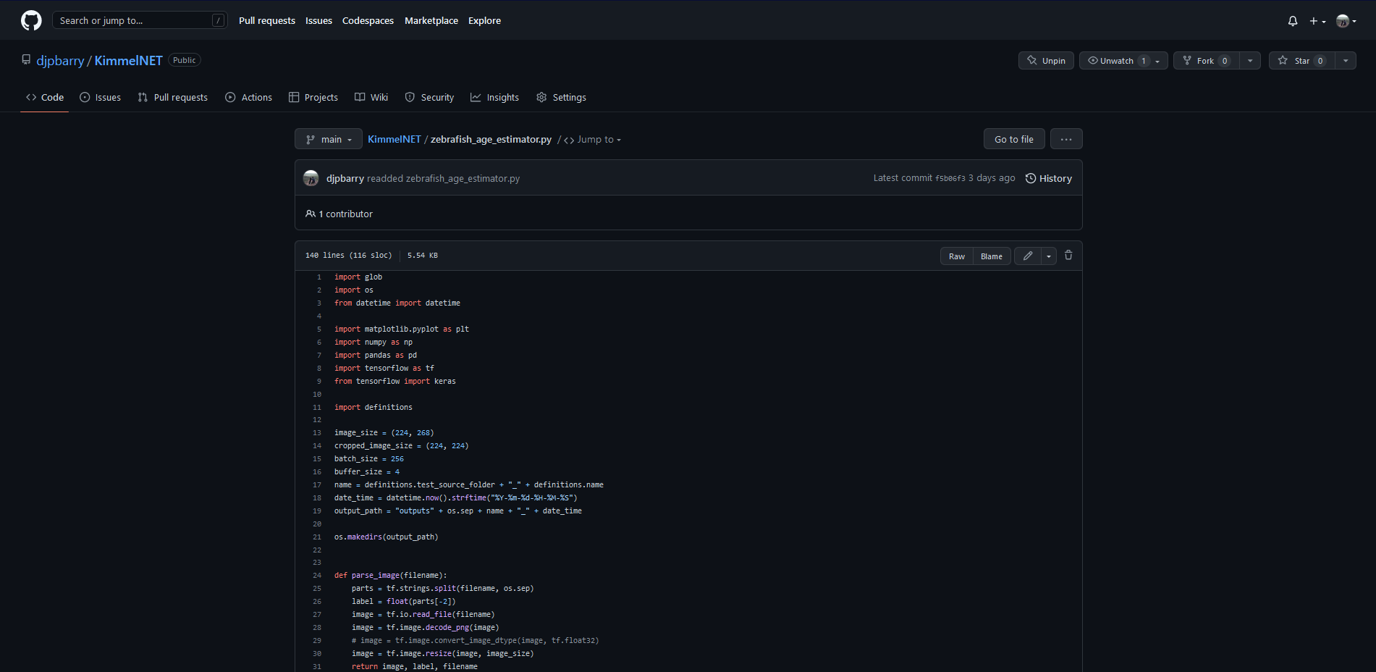

Slide 9
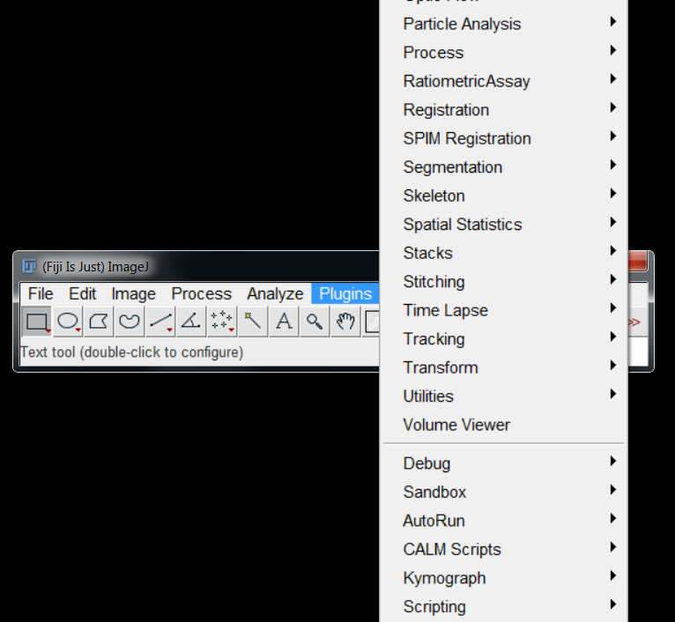
Plugins versus scripts/macros
Either can be “installed” on the Plugins menu…
…but there are important distinctions.

Slide 10
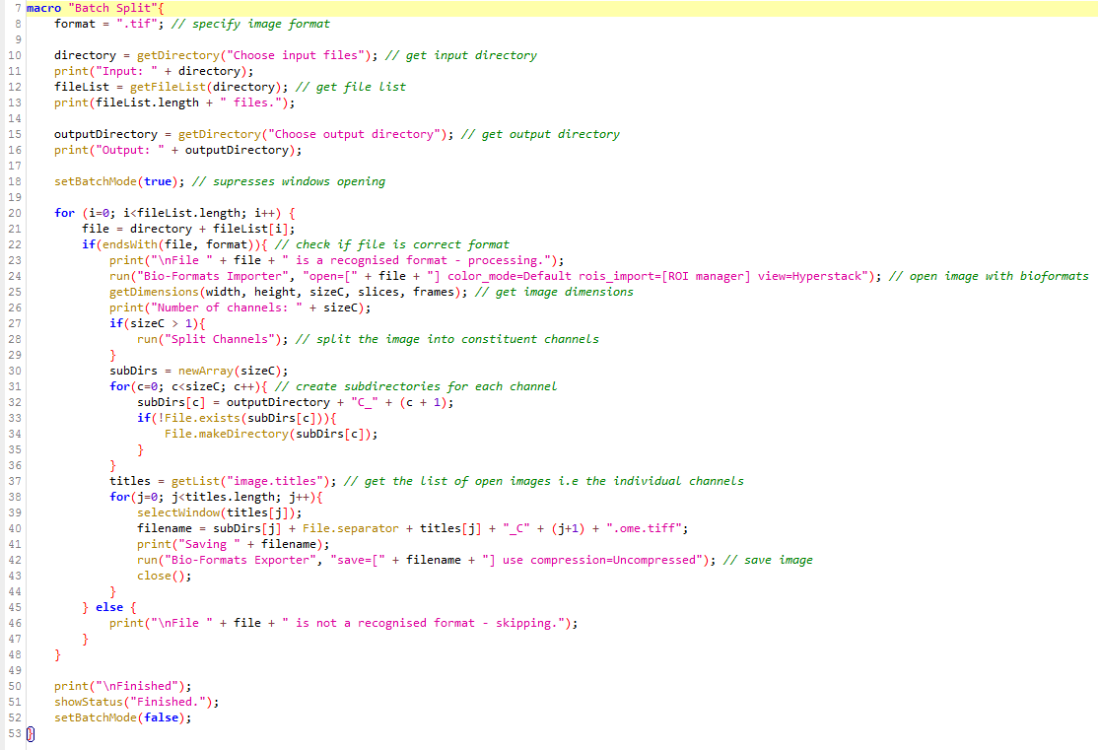
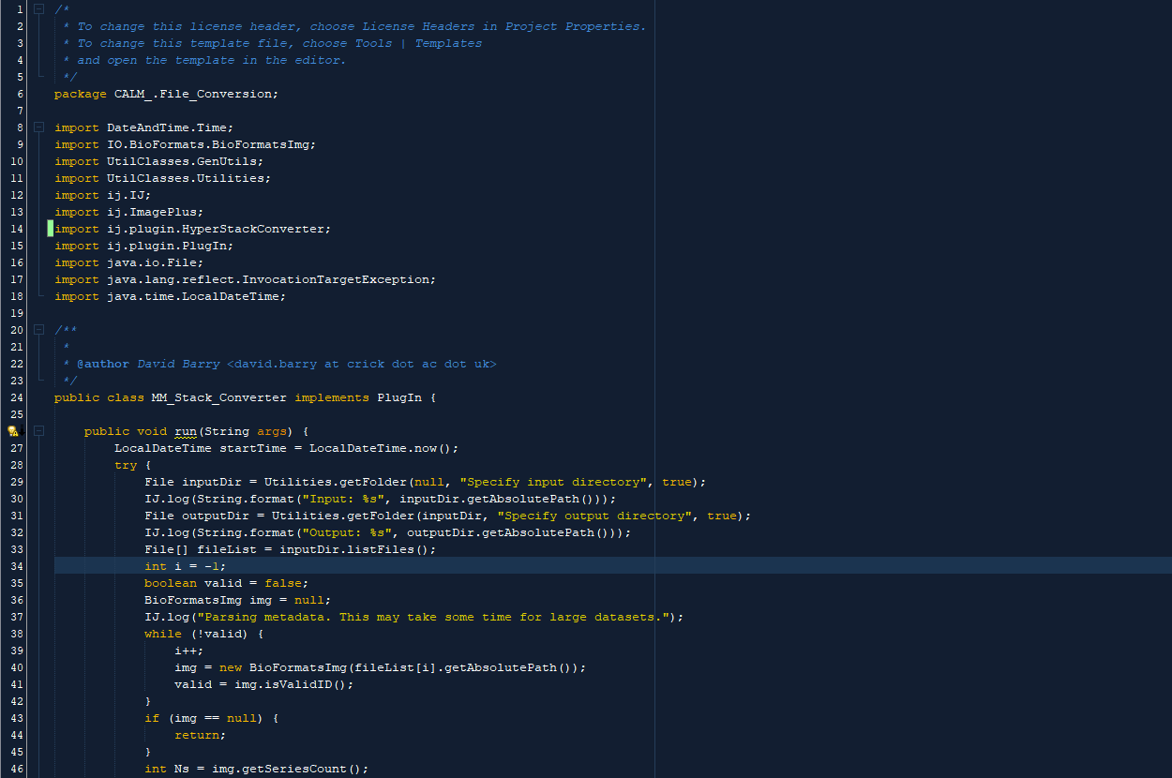
Plugins versus scripts/macros
Script/Macro – IJ Macro Language
PlugIn - Java
Both are essentially just text files, but…
Scripts are interpreted
Plugins are compiled

Slide 11


Easier to write, but slower execution
// Dave Barry, Francis Crick Institute // 2018.01.17 // david.barry@crick.ac.uk // Converts all files in a directory to TIFF - there will be one TIFF file per channel per input file. macro "Batch Split"{ directory = getDirectory("Choose input files"); IJ.log("Input: " + directory); fileList = getFileList(directory); IJ.log(fileList.length + " files."); outputDirectory = getDirectory("Choose output directory"); IJ.log("Output: " + outputDirectory); run("Bio-Formats Macro Extensions"); setBatchMode(true); for (i=0; i<fileList.length; i++) { file = directory + fileList[i]; Ext.isThisType(file, thisType); if(thisType=="true"){ IJ.log("\nFile " + file + " is a recognised format - processing."); Ext.setId(file); Ext.getSizeC(sizeC); Ext.getSeriesCount(sCount); Ext.getDimensionOrder(dimOrder); IJ.log("Number of series: " + sCount); IJ.log("Number of channels: " + sizeC); for(s=1;s<=sCount;s++){ run("Bio-Formats Importer", "open=[" + file + "] color_mode=Default rois_import=[ROI manager] view=Hyperstack stack_order=" + dimOrder + " use_virtual_stack series_" + s); //if(sizeC > 1){ //run("Split Channels"); //} //subDirs = newArray(sizeC); //for(c=0;c<sizeC;c++){ //subDirs[c] = outputDirectory + "C_" + (c + 1); //if(!File.exists(subDirs[c])){ //File.makeDirectory(subDirs[c]); //} //} titles = getList("image.titles"); for(j=0; j<titles.length; j++){ selectWindow(titles[j]); index = lastIndexOf(titles[j], "."); titles[j] = substring(titles[j], 0, index); //filename = subDirs[j] + File.separator + titles[j] + "_S" + s + "_C" + (j+1) + ".ome.tiff"; filename = outputDirectory + titles[j] + "_S" + s + ".ome.tiff"; filename = replace(filename, " ", "-"); IJ.log("Saving " + filename); run("Bio-Formats Exporter", "save=" + filename + " use compression=Uncompressed"); close(); } } Ext.close(); } else { IJ.log("\nFile " + file + " is not a recognised format - skipping."); } } IJ.log("\nFinished"); showStatus("Finished."); setBatchMode(false); function saveFile(outFile) { run("Bio-Formats Exporter", "save=[" + outFile + "] compression=Uncompressed"); } }
0010011111010100101001000110101010101010101010100101001010110101000110100101101001100
Generate Output
Harder to write, but faster and more efficient

Slide 12
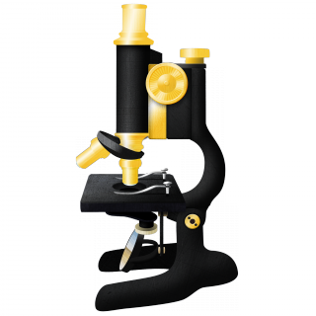











Slide 13
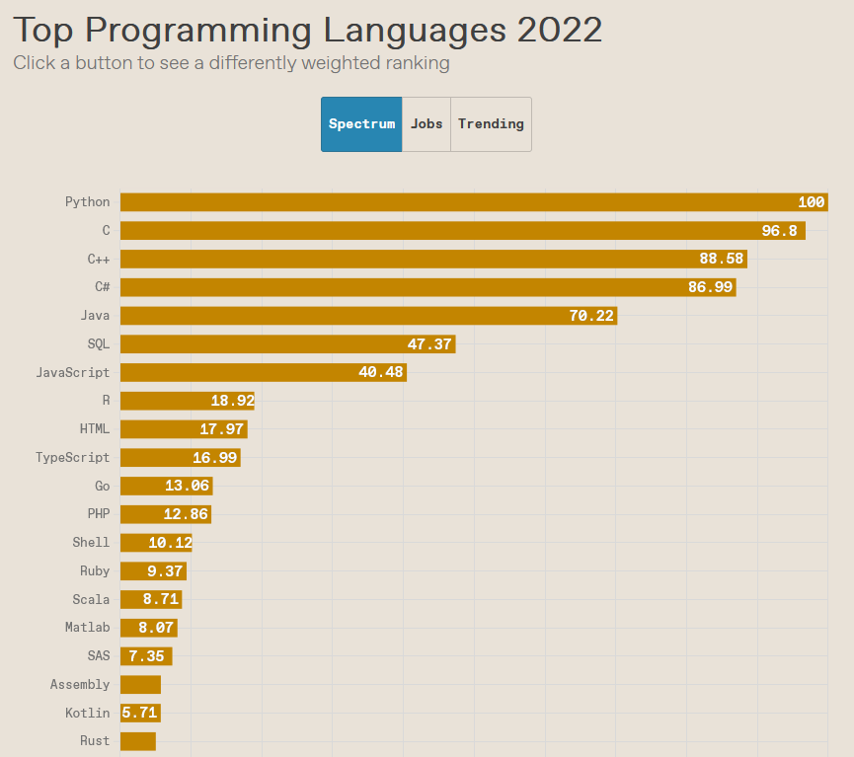
IEEE Spectrum’s Top Programming Languages 2022

Slide 14
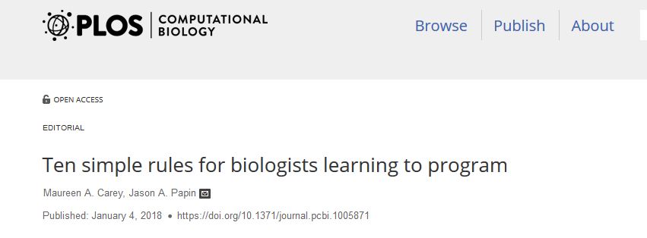
Just do it
Baby steps are steps
Don’t reinvent the wheel
Develop good habits early on

Slide 15
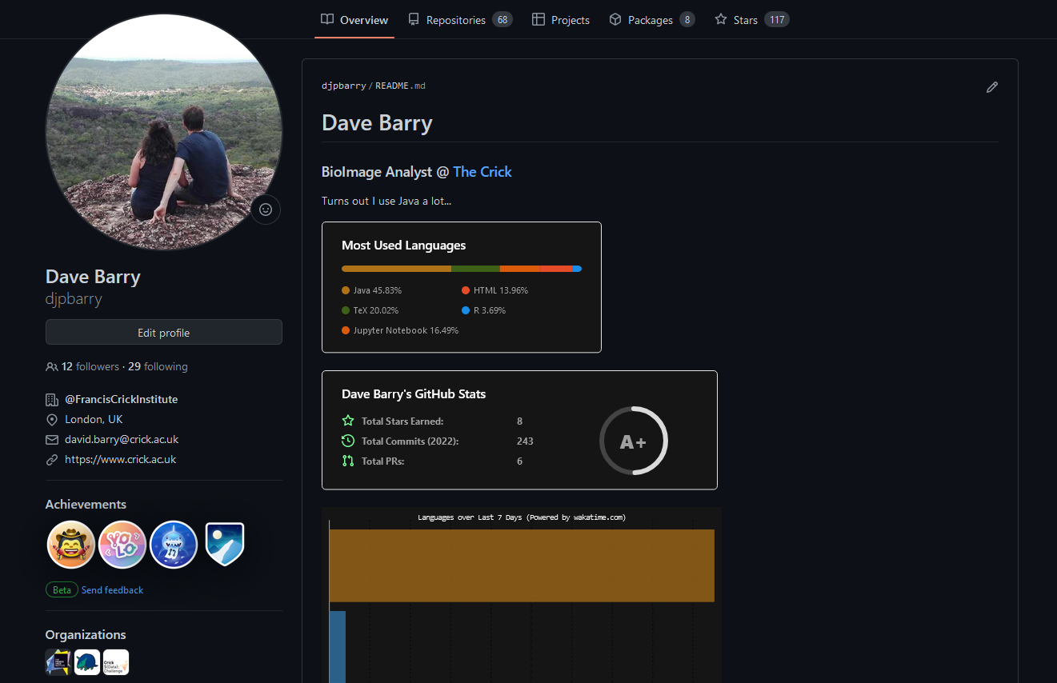
https://github.com

Slide 16


Warning
There’s no way you’re going to master this in a few hours…

Slide 17
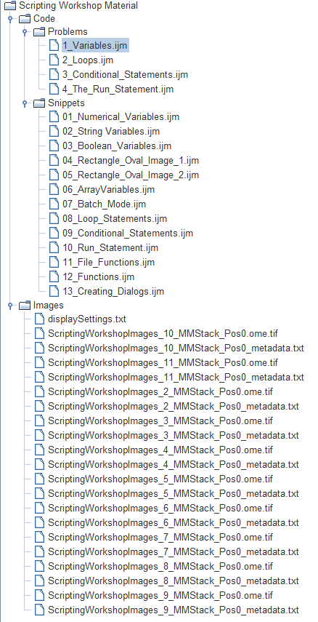
There is a prize (and pride) at stake
3 Teams
6 Quizzes/Problems
1 - 3 Challenges

Slide 18
Quiz 1 – How much work will you do?
Today, you are going to write a script to automatically load a series of images in a folder, perform a simple operation on each image, then save the result.
Approximately how many lines of code will there be in the finished script?
10
50
100
200
1000

Slide 19
1 – Getting Started

Slide 20
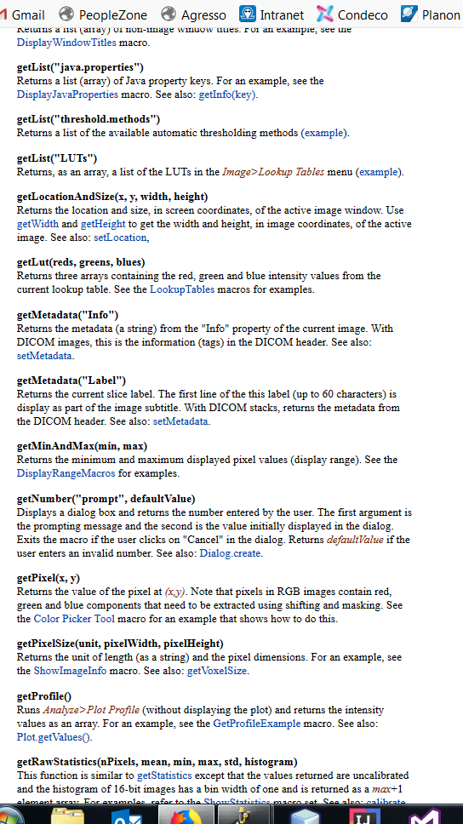
IJ Macro Language
Interpreted scripting language
Specific for FIJI/ImageJ
Has much in common with other languages
Easy to learn
Less flexibility
Full list of commands: https://imagej.nih.gov/ij/developer/macro/functions.html

Slide 21
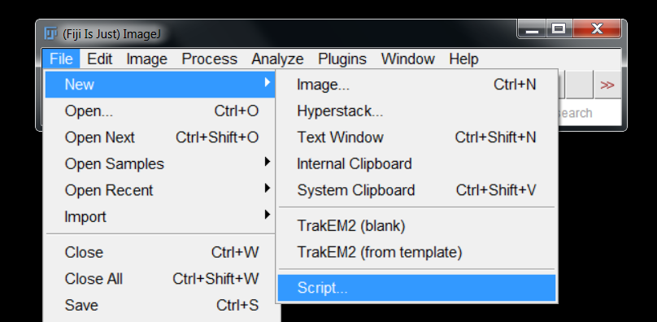
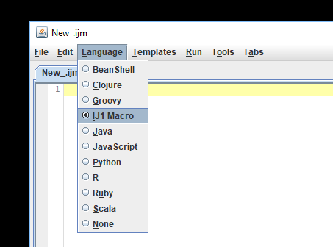
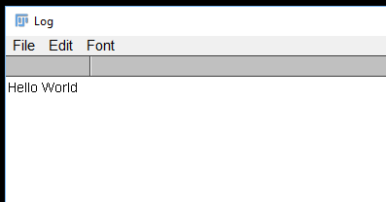
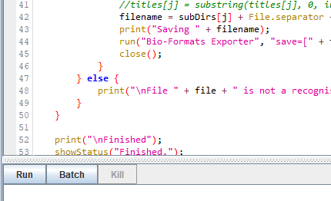
“Hello World” Example
Traditionally used as a starting point for illustrating the syntax of a new language
print("Hello World");

Slide 22
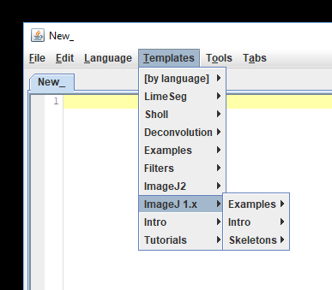
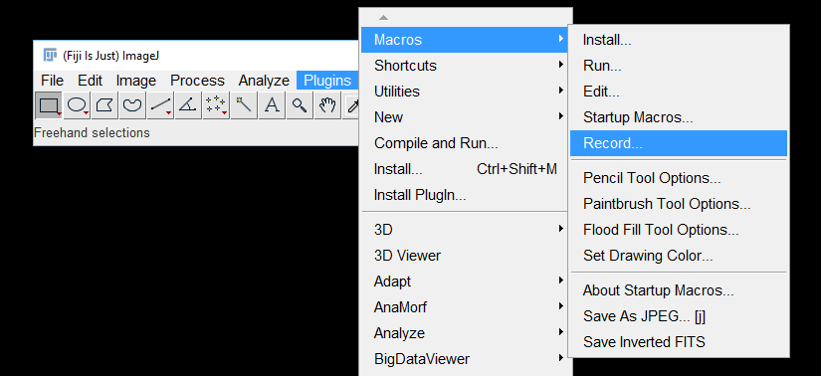
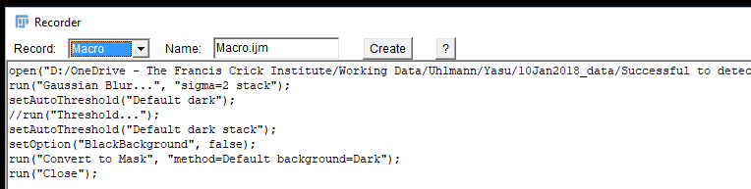
When starting a new script…
The script editor has numerous templates
Alternatively, use the macro recorder
If all else fails, search online

Slide 23
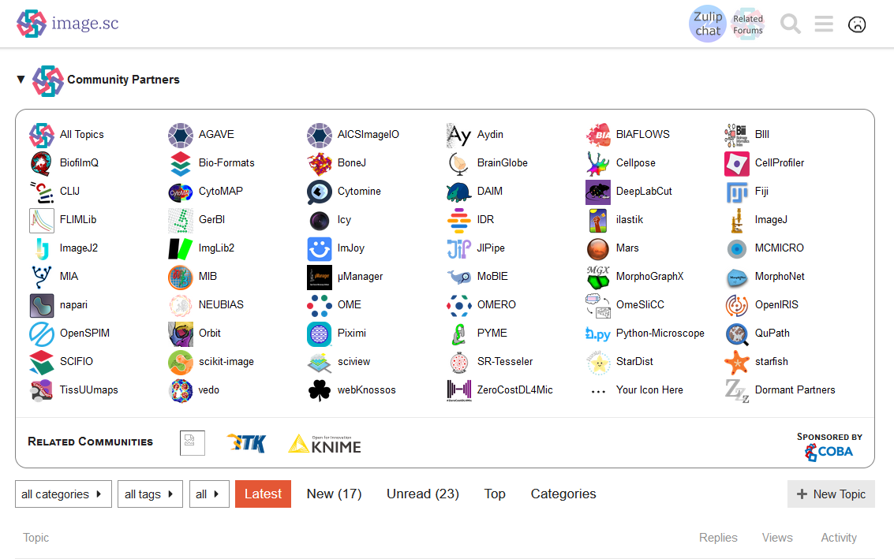
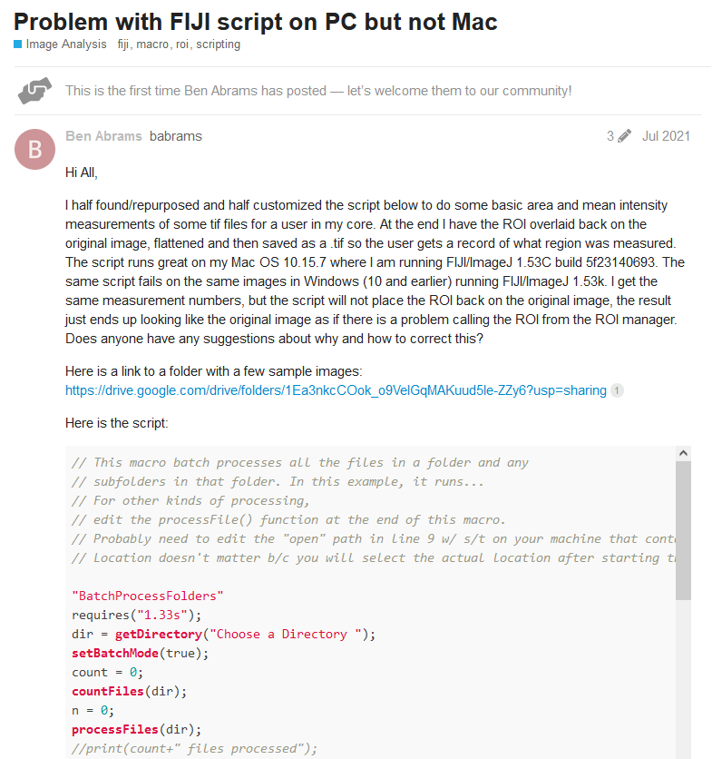

Slide 24
Get into the habit of using Comments
Used to annotate and document code
Denoted by a double backslash
Longer comments can be enclosed with /* … */ notation
“Programs must be written for people to read, and only incidentally for machines to execute.” - Harold Abelson
// Version 2.017
// March 28th 2018
// david.barry@crick.ac.uk
/*
Prints "Hello" to the console.
Takes no parameters as arguments.
Returns nothing.
Not a terribly useful function really.
*/
function hello() {
print("Hello");
}

Slide 25
Naming Macros
Defining Variables
IJ Macro Functions
Conditional
Statements
Comments

Slide 26
2 – Dealing with Errors

Slide 27
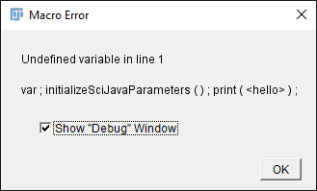
Carefully read error messages

Slide 28
3 – name your macro

Slide 29
Name your macros logically
// Dave Barry, Francis Crick Institute
// 2018.01.17
// david.barry@crick.ac.uk
// Converts all files in a directory to TIFF - there will be one TIFF file per channel per input file.
macro "Batch Split"{
// Lots of code here...
}
Tells you what your code does!
Allows macro to be loaded into plugins menu

Slide 30
4 – Defining Variables

Slide 31
Literals
Fixed value within source code
Number, character or String
5486.25214
-3
14
“Hello”
“3.14”
‘A’
“3,427”
‘7’
“C:/Users/barryd/documents/image.tiff”
“David”

Slide 32

Variables
A variable is a placeholder for a changing entity
Assigning a name to a memory location
This is referred to as variable assignment
1000
area = 1000;
print(area);
Print(Area);
This will produce an error
area
Variable names are ALWAYS case sensitive:
“Area” and “area” are two different variables

Slide 33
Variable Arithmetic
width1 = 640;
height1 = 480;
area1 = width1 * height1;
area2 = area1 * 1.2;
width2 = area2 / height1;
combined_area = area1 + area2;
area_difference = area2 – area1;

Slide 34
Variables can be self-referenced
In a variable assignment statement, the right-hand side is evaluated first, then the variable is assigned the result
counter = 1;
counter = counter + 1;

Slide 35
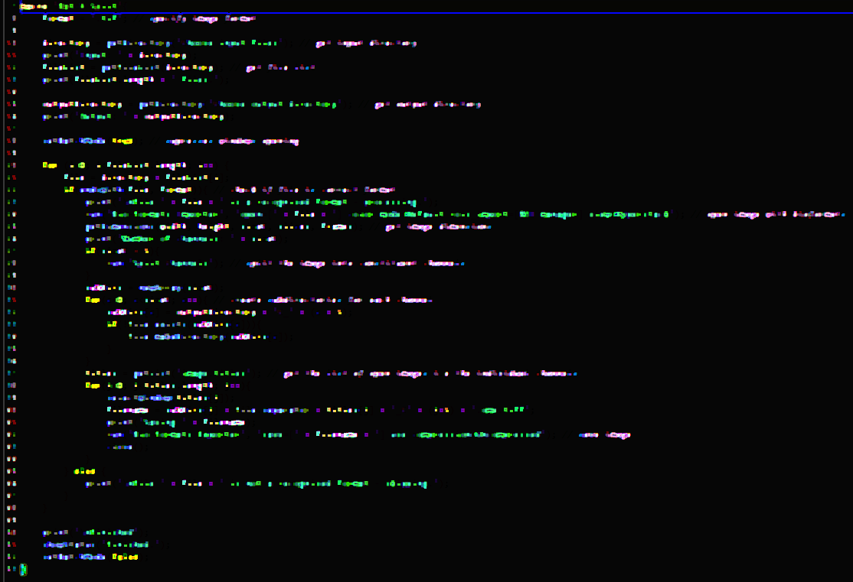
DEMO 1 – Numerical Variables
Open Snippets/01_Numerical_Variables.ijm
width

Slide 36


Quiz 2 - Algebra
Click on the link to the Google Form on Slack and answer as many of the questions as you can.

Slide 37
Why the semi-colon?
;
Equivalent to a full-stop
Required after every statement
Provides structure to the programming language

Slide 38
Variables don’t have to be numbers…
They can also be strings - a “string” of characters…
a = “Analysis_";
b = “output";
c = a + b;
print(c);
…which can be manipulated:
This is called string “concatenation”
IJ Macro language has numerous string functions:
substring(string, index1, index2)
Returns a new string that is a substring of string.
toString(number, decimalPlaces)
Converts number into a string, using the specified number of decimal places.

Slide 39
DEMO 2 – String Variables
Open Snippets/02_String_Variables.ijm
width

Slide 40
Variables can also be boolean
True
False
1
0
continue = count < 10; too_big = area > 10000;
Commonly used in flow control statements
Examples of Macro language functions that produce Boolean results:
endsWith(string, suffix)
Returns true if string ends with suffix.
File.exists(path)
Returns "1" (true) if the specified file exists.

Slide 41
Suppose you want to obtain THE INVERSE OF A BOOLEAN VARIABLE…
!
a = true;
b = !a;
// b is now false
continue = !(count < 0);
just_right = !(area < 100);

Slide 42
Testing equality
==
!=
a = 0;
b = 1;
c = a == b; // c is false
d = a != b; // d is true

Slide 43
DEMO 3 – Boolean Variables
Open Snippets/03_Boolean_Variables.ijm
width

Slide 44
DEMO 4 – Variables make code more readable
newImage("New Image", "16-bit", 640, 480, 1);
drawRect(640 * 0.1, 480 * 0.1, 640 - 2 * 640 * 0.1, 480 - 2 * 480 * 0.1);
fillOval(640 * 0.2, 480 * 0.2, 640 - 2 * 640 * 0.2, 480 - 2 * 480 * 0.2);

Slide 45
Arrays
file0 = "image.tif";
file1 = "image1.tif";
file2 = "image2.tif";
An array is a collection of variables, each referenced by an index:
0
1
2
3
4
5
files
length
files = newArray(6);
files[0] = "image.tif";
files[1] = "image1.tif";
…
print(files[3]);
Length_Of_File_List = files.length;

Slide 46
Arrays
A number of IJ Macro functions return arrays:
getFileList(directory)
Returns an array containing the names of the files in the specified directory path.
getList("image.titles")
Returns a list (array) of image window titles.

Slide 47
DEMO 6 – Arrays
Open Snippets/06_Arrays.ijm
width

Slide 48
Problem 1 – Variables
Open Problems/1_Variables.ijm
One point for each problem solved
width

Slide 49
Useful references
https://doi.org/10.1371/journal.pcbi.1007433
https://doi.org/10.1371/journal.pcbi.1005871

